Slide 1
Web Development 3
Lecture 6 – DOM Scripting
Lecturer: James Byrne (jamesbyrne@ait.ie)

Slide 2

Topics
ECMAScript Overview
DOM Specifications
Concept of nodes
Node Types
DOM getters
DOM setters
id, title and href properties
querySelector

Slide 3
ECMAScript (ES)
The ECMAScript specification is a standardized specification of a scripting language developed by Brendan Eich of Netscape
Initially it was named Mocha, later LiveScript, and finally JavaScript
Standard for JavaScript
New revisions almost yearly, usually around June

Slide 4
ECMAScript (ES) - Versions
ES1 June 1997
ES2 June 1998
ES3 Dec. 1998
ES4 Abandoned
ES5 Dec. 2009
ES6 or ES2015 – 2015 ← Still most widely used version
ES2016 (ES7)
ES2017 (ES8)
ES2018 (ES9)
ES2020 (ES10)

Slide 5
DOM Standards
DOM Level 1
DOM Level 2 :2000
DOM Level 3 :2005
DOM Level 4 : 2015 (WHATWG living doc.)

Slide 6
Document Object Model
Early browsers gave JavaScript limited access to some parts of the currently loaded document, but this was implemented by competing browsers in different ways
The W3C produced the DOM, which provides a standard way of modelling web pages as a collection of objects and allows access to any part of a document
The core DOM models any XML document. The HTML DOM adds additional objects which are specific to HTML and XHTML documents

Slide 7
The DOM Nodes
A Web page can be viewed as a network of interconnected nodes
There are three basic types of node that make up a document:
  element nodes,
  text nodes,
  attribute nodes
There is also comment nodes and the document node itself
structure
content

Slide 8
The DOM Nodes
<p title=“a gentle reminder”>Don’t forget to buy stuff.</p>
p
Element Node
title=“a gentle reminder”
Don’t forget to buy stuff
Attribute Node
Text Node

Slide 9
The DOM Nodes
<<!DOCTYPE html>
<html>
<head>
<title>Simple page</title>
</head>
<body>
<h1>welcome</h1>
<p id=“intro”>This is a very simple document.</p>
</body>
</html>

Slide 10
The DOM Nodes
HTML
HEAD
BODY
id=“intro”
TITLE
H1
P
Simple Page
Welcome
This is a very simple document

Slide 11
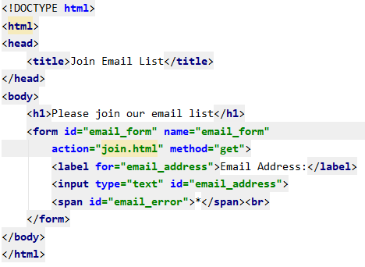
Document Object Model

Slide 12
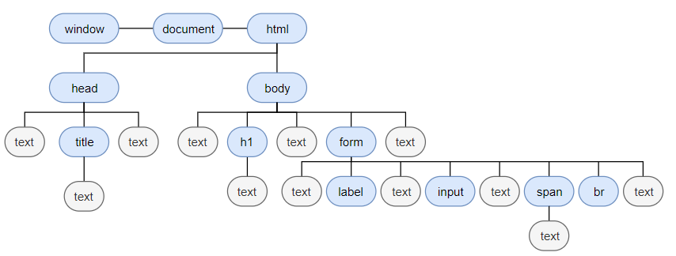
Document Object Model

Slide 13
The Inheritance Hierarchy for DOM Nodes

Slide 14
DOM - Getters
The DOM provides a number of methods for accessing the individual components of a document. These methods are called getters
getElementById
  <div id=“example>
  </div>
  To access the “example” div with the DOM, you can use the getElementByID method of the document object:
  var mydiv=document.getElementById(“example”);

Slide 15
DOM - Getters
getElementsByTagName
  var paragraphs =document.getElementByTagName(“p”);
  The variable paragraphs now contains a collection of the p elements in the document. This collection can be treated as an array
  alert(paragraphs.length); will show how many paragraphs in the document
  for (var i=0;i<paragraphs.length; i++){
  // do something with paragraph[i]
  }

Slide 16
DOM - Getters
getElementsByClassName
  var boldElems =document.getElementByClassName(“boldText”);
  The boldElems now contains a collection of all the elements in the document with class=“boldText”. This collection can be treated as an array
  alert(boldElems.length); will show how many elements are in the returned array
  for (var i=0;i< boldElems.length; i++){
  // do something with boldElems[i]
  }

Slide 17
DOM - Getters
getElementsByName
  var animals =document.getElementByName(“animal”);
  The animals now contains a collection of all the elements in the document with name=“animal”. This collection can be treated as an array
  alert(animals.length); will show how many elements are in the returned array
  for (var i=0;i< animals.length; i++){
  // do something with animals[i]
  }

Slide 18
DOM - Getters
getAttribute
  The DOM allows you to retrieve the value for an attribute as well
  <p id=“intro” title=“introductory message”>
  </p>
  Using the getAttribute method, you can retrieve the value of this attribute:
  var introduction=document.getElementById(“intro”);
  var title_text=introduction.getAttribute(“title”);
title_text variable now contains the string ”introductory message”

Slide 19
DOM Node Types

Slide 20
Node Properties

Slide 21
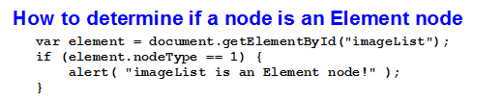
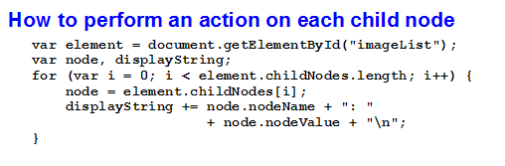
Determining Node Types & Actions

Slide 22
Methods of the Node Object

Slide 23
The Document Interface
The element node for the <html> tag

Slide 24
The Document Interface - methods

Slide 25
The Document Interface - methods

Slide 26
The Element Interface - methods

Slide 27
The HTMLElement Interface

Slide 28
The HTMLElement Interface

Slide 29
The HTMLElement Interface

Slide 30
The HTMLElement Interface

Slide 31
The HTMLElement Interface

Slide 32
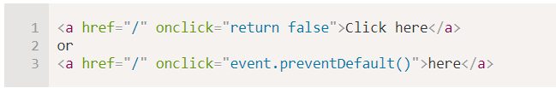
Default Actions
“return false” will cancel the default action

Slide 33
DOM - parentNode
parentNode-childNode relationships can be accessed through DOM properties.
  parentNode
  var introduction=document.getElementById(“intro”);
  var container=introduction.parentNode;
Now contains a reference to the body element

Slide 34
DOM - childNodes
  firstChild
  The firstChild property of an element node will return a reference to the first node in the element’s childNodes collection. i.e. childNodes[0]
  lastChild
  Returns a reference to the last node in an element’s childNodes property.
  previousSibling
  Returns a reference to the node that comes before it in the parent’s childNodes property.
  nextSibling
  Returns a reference to the node that comes after it in the parent’s childNodes property.

Slide 35

DOM - nodeValue
  The DOM methods and properties allow you to navigate around a document from any starting point, but to retrieve content you need to use the nodeValue property.
  var introduction=document.getElementById(“intro”);
  alert(introduction.nodeValue);
Will give a result of null
nodeValue of any element is null

Slide 36
DOM - nodeValue
  What we want to get is the value of the text node contained within the element.
  var introduction=document.getElementById(“intro”);
  var text=introduction.firstChild;
  alert(introduction.nodeValue);
  var headers =document.getElementByTagName(“h1”);
  var text=headers[0].firstChild;
  alert(text.nodeValue);

Slide 37
DOM – Creating Markup
  DOMs methods : createElement, createTextNode, appendChild, removeChild, setAttribute and insertBefore

Slide 38
DOM – Setters
  The real power of the DOM is its ability to manipulate the node tree. DOM methods let you add and remove nodes from a document. There are methods for
    creating element nodes,
    creating text nodes
    attribute nodes
  createElement
  var para=document.createElement(“p”);
Doesn’t appear in the document yet

Slide 39
DOM – Setters
    createTextNode
    var text=document.createTextNode(“This text was added”);
    setAttribute
    para.setAttribute(“title”,”generated content”);
Won’t automatically appear in the document
attribute name and value

Slide 40
DOM – Setters
    appendChild
    var para=document.createElement(“p”);
    var text=document.createTextNode(“This text was added”);
    para.appendChild(text);
    removeChild
    var introduction=document.getElementById(“intro”);
    var text=introduction.firstChild;
    introduction.removeChild(text);
Now it will be added to the document, need to append
Removes text node inside paragraph with id “intro”

Slide 41
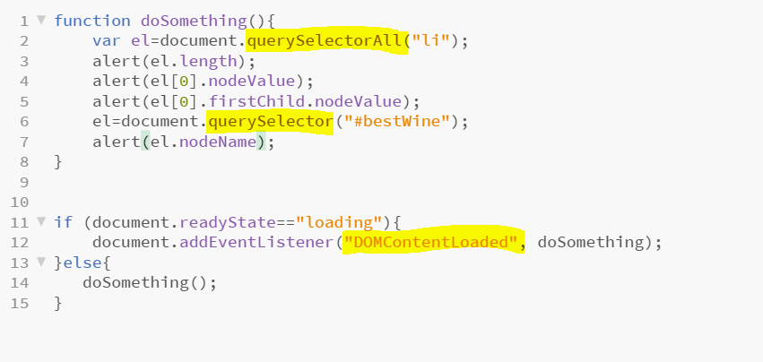
HTML DOM Method - querySelector
    querySelector uses CSS selectors to select elements in the DOM

